Slide 1

The Church-Turing Thesis
Chapter 18

Slide 2
Are We Done?
FSM ⇒ PDA ⇒ Turing machine
Is this the end of the line?
There are still problems we cannot solve:
● There is a countably infinite number of Turing machines
since we can lexicographically enumerate all the strings
that correspond to syntactically legal Turing machines.
● There is an uncountably infinite number of languages over
any nonempty alphabet.
● So there are more languages than there are Turing
machines.

Slide 3
What Can Algorithms Do?
Can we make all true statements theorems?
Can we decide whether a statement is a theorem?

Slide 4
The Entscheidungsproblem
  David Hilbert (1928)
  Does there exist an algorithm to decide, given an arbitrary sentence w in first order logic, whether w is valid?
  Given a set of axioms A and a sentence w, does there exist an algorithm to decide whether w is entailed by A?
  Given a set of axioms, A, and a sentence, w, does there exist an algorithm to decide whether w can be proved from A?

Slide 5
Gödel’s Incompleteness Theorem
Kurt Gödel showed, in the proof of his Incompleteness Theorem [Gödel 1931], that the answer to Hilbert’s question is no. In particular, he showed that there exists no decidable axiomatization of Peano arithmetic that is both consistent and complete.

Slide 6
Negative answer – Church, Turing
To answer the question, in any of these forms, requires formalizing the definition of an algorithm:
  Church: lambda calculus - 1935
  Turing: Turing machines – 1936
Church proved that there is no computable function which decides for two given lambda calculus expressions whether they are equivalent or not
Turing reduced the halting problem for Turing machines to the Entscheidunsproblem
Turing proved that Turing machines and the lambda calculus are equivalent.

Slide 7
Church's Thesis
(Church-Turing Thesis)
All formalisms powerful enough to describe everything we think of as a computational algorithm are equivalent.
This isn’t a formal statement, so we can’t prove it. But many different computational models have been proposed and they all turn out to be equivalent.

Slide 8
The Church-Turing Thesis
Examples of equivalent formalisms:
● Modern computers (with unbounded memory)
● Lambda calculus
● Partial recursive functions
● Tag systems (FSM plus FIFO queue)
● Unrestricted grammars:
aSa → B
● Post production systems
● Markov algorithms
● Conway’s Game of Life
● One dimensional cellular automata

Slide 9
The Lambda Calculus
The successor function:
(λ x. x + 1)
(λ x. x + 1) 3 = 4
Addition: (λ x. λ y. x + y) 3 4
This expression is evaluated by binding 3 to x to create the new function (λ y. 3 + y), which is applied to 4 to return 7.
In the pure lambda calculus, there is no built in data type number. All expressions are functions. But the natural numbers can be defined as lambda calculus functions. So the lambda calculus can effectively describe numeric functions just as we have done.

Slide 10
Tag Systems
A tag system (or a Post machine) is an FSM augmented with a FIFO queue.
A tag system for WW:
A tag system for WW^{R}:
Tag systems are equivalent in power to Turing machines because the TM’s tape can be simulated with the FIFO queue.
Idea: treat the queue as a loop

Slide 11
Post Production Systems
A Post system P is a quintuple (V, Σ, X, R, S):
● V is the rule alphabet,
● Σ is a subset of V,
● X is a set of variables with values in V*,
● R (the set of rules) is a finite subset of:
(V ∪ X)* × (V ∪ X)*
Every variable on the RHS must also be on the LHS.
● S can be any element of V - Σ.
● LHS may contain multiple symbols.
● Rules may contain variables.
● LHS must match entire string. So, A → B becomes:
XAY → XBY

Slide 12
A Post Production System
WW = {ww : w ∈ {a, b}*}.
P = ({S, a, b}, {a, b}, {X, Y}, R, S), R =
(1) XS → XaS /* Generate (a ∪ b)* S.
(2) XS → XbS ″
(3) XS → XX /* Create a second copy of X.
This Post system can generate, for example, the string abbabb:
S ⇒ (using (1) and letting X match ε)
aS ⇒ (using (2) and letting X match a)
abS ⇒ (using (2) and letting X match ab)
abbS ⇒ (using (3) and letting X match abb)
abbabb

Slide 13
Markov Algorithms
A Markov algorithm M is a triple (V, Σ, R), where:
● V is the rule alphabet, which contains both working symbols
and input symbols. If M is a decider or a semidecider, V will
contain two special working symbols, Accept and Reject.
● Σ is a subset of V, and
● R is an ordered list of rules, each of which is an
element of V* × V*. There are two kinds of rules:
  ● Continuing, written as X → Y, and
  ● Terminating, written as X →• Y
As with Turing machines, there is no special start symbol, but there will be an input string.

Slide 14
A Markov Algorithm Interpreter
Markovalgorithm(M, w) =
1. Until no rules apply or the process has been terminated by
executing a terminal rule do:
  1.1 Find the first rule in the list R that matches against w.
  If that rule matches w in more than one place, choose
  the leftmost match.
  1.2 If no rule matches then exit.
  1.3 Apply the matched rule to w by replacing the substring
  that matched the rule’s LHS with the rule’s RHS.
  1.4 If the matched rule is a terminating rule, exit.
2. If w contains the symbol Accept then accept.
3. If w contains the symbol Reject then reject.
4. Otherwise, return w.
Notice: Markov algorithms are deterministic.

Slide 15
A Markov Algorithm for A^{n}B^{n}C^{n}
(1) #a → %
(2) #b → • Reject
(3) #c → • Reject
(4) %a → a%
(5) %b → ?
(6) % → • Reject
(7) ?b → b?
(8) ?c → ε
(9) ? → • Reject
(10) # → • Accept
(11) ε → #
Example: aabbbccc

Slide 16
The Power of Markov Algorithms
Theorem: The Markov algorithm formalism is equivalent in power to the Turing machine.
Proof: By two constructions. Show that each formalism can simulate the other.

Slide 17
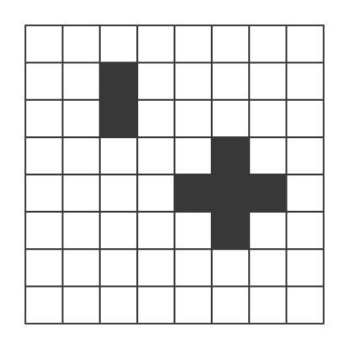
The Game of Life
Playing the game
At each step of the computation, the value for each cell is determined by computing the number of neighbors (up to a max of 8) it currently has, according to the following rules:
● A dead cell with exactly three live neighbors becomes a live cell
(birth).
● A live cell with two or three live neighbors stays alive (survival).
● In all other cases, a cell dies or remains dead (overcrowding or
loneliness).
We’ll say that a game halts iff it reaches some stable configuration.

Slide 18

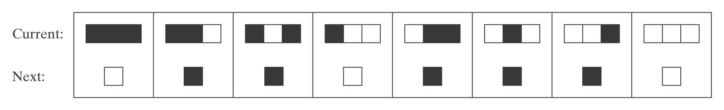
Elementary Cellular Automata
Wolfram’s Rule 110 is a universal computer if you can
figure out how to encode the program and the input in the
initial configuration:

